Slide 1



UNIT 4;
Every man is an artist
A Biography

Slide 2
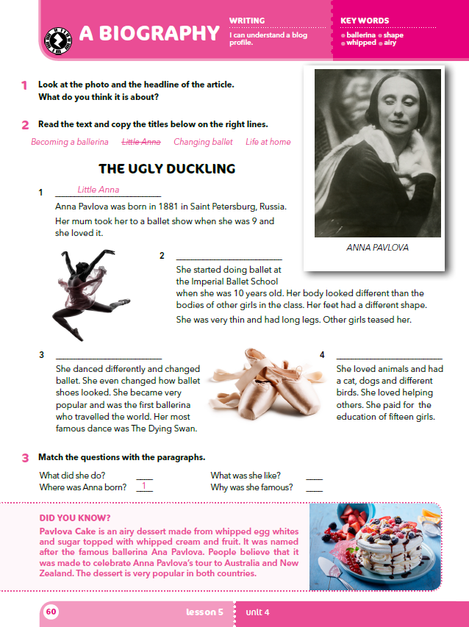
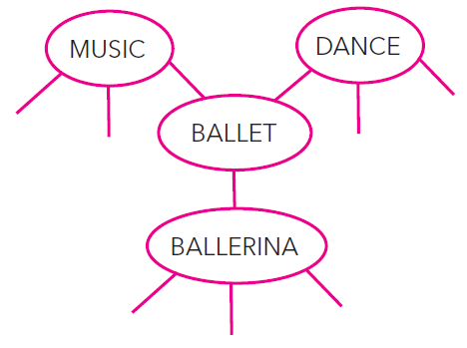
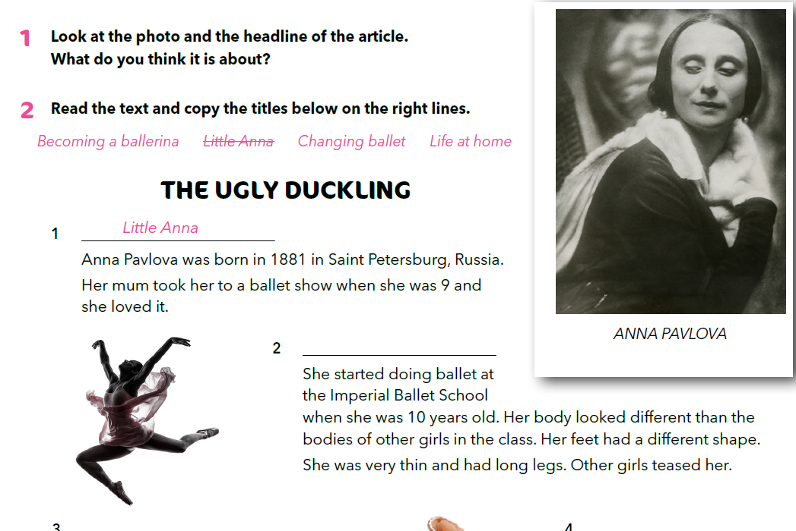
Look at the photo and the headline of the article. What do you think it is about?
Can you see any connection between the title and ballet?
What do swans and ballerinas have in common?
Create BALLET mental map.
?
Can you guess who Anna Pavlova was?
Can you guess if she was popular when she was a little girl?

Slide 3

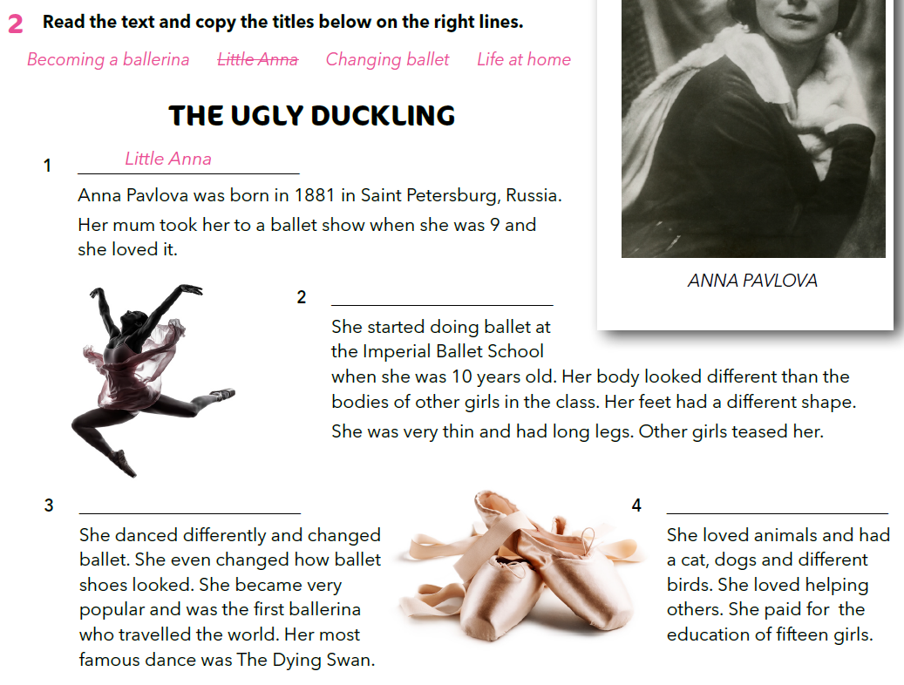
Becoming a ballerina
Changing ballet
Life at home

Slide 4
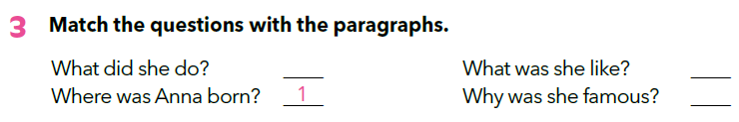
Where was Anna Pavlova born?
How old was she when she first attended a ballet lesson?
What made her body look different?
Was she popular with other girls?
Did she travel a lot?
Did she love people?
Did she love animals?
What was The Dying Swan?
2
4
3
Match the questions with the paragraphs.
Becoming a ballerina
Changing ballet
Life at home

Slide 5
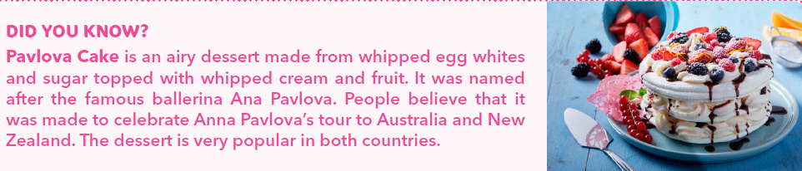
Find about meringue:
https://www.bbcgoodfood.com/recipes/2445/ultimate-meringue

Slide 6
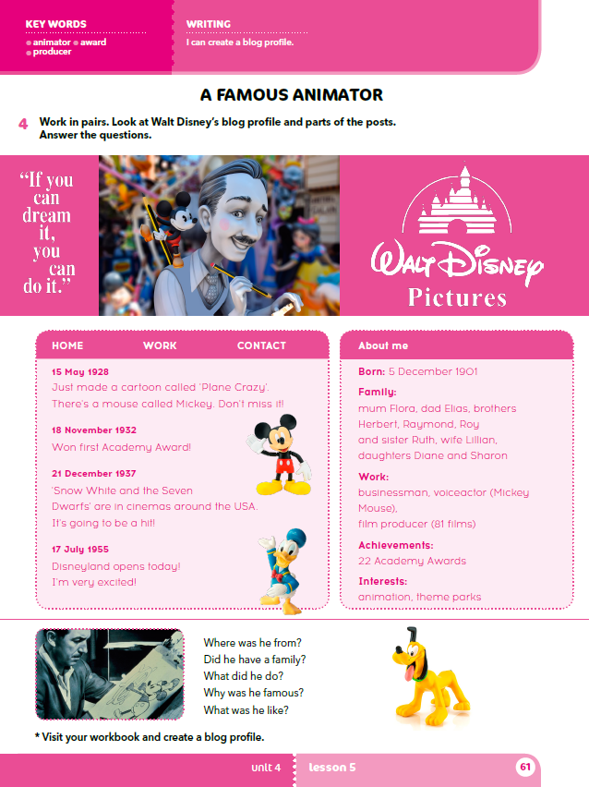
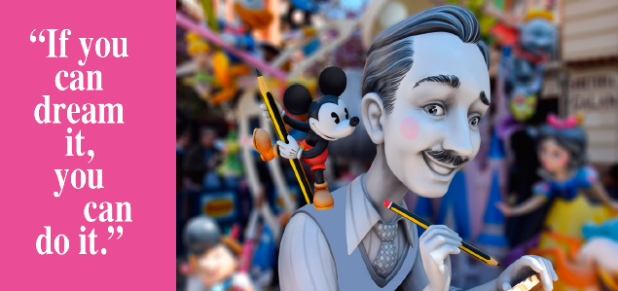
What do you know about Walt Disney?
What do you usually dream about?
Do you only dream at night while you are sleeping?
What does it mean when people say that somebody has big dreams?
What does it mean when you say that your dream came true?
Have any of your dreams ever come true?
Did you do something to make it come true or did it happen by chance?
Are you dreaming about something nowadays?
What would you have to do to make it come true?
Are you ready to do it?

Slide 7
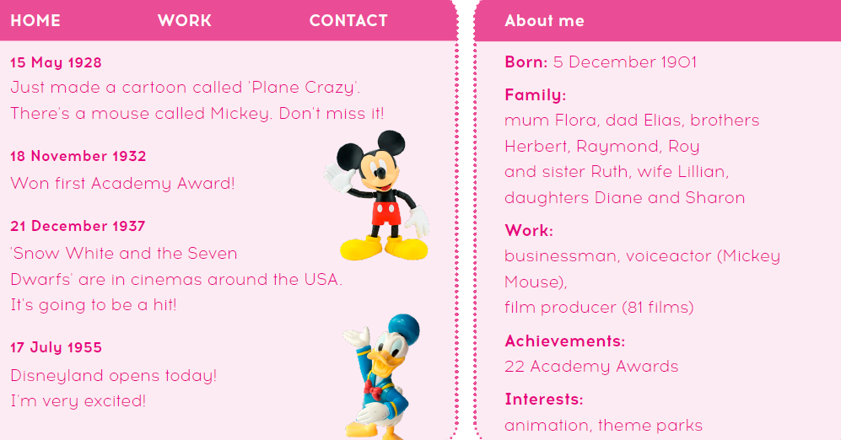
When was he born?
Was he married?
When did he win his first Academy Award?

Slide 8
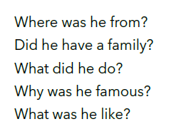
Answer the questions.
1 He was from the USA.
2 Yes, he did. He had mum, dad, three brothers, one sister, a wife and two daughters.
3 He was a businessman and a voiceactor.
4 He was famous because he created Mickey Mouse. 5 He loved animation and theme parks. He won many awards and he created Disneyland.
Practise:
https://wordwall.net/play/902/546/283

Slide 9
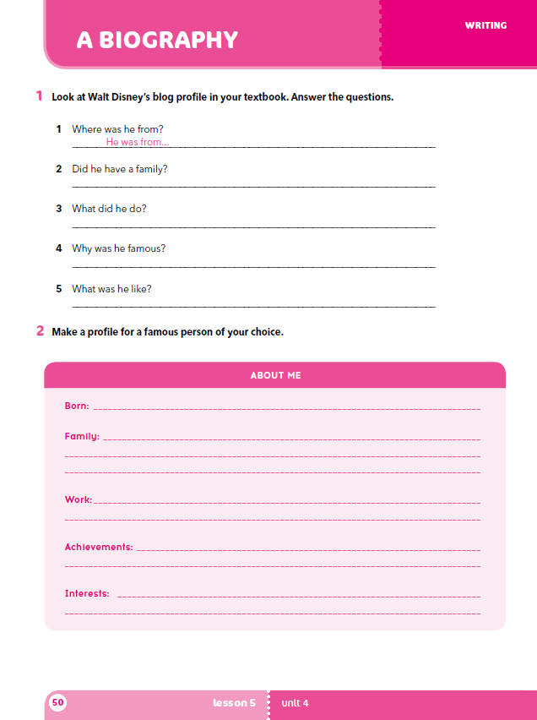
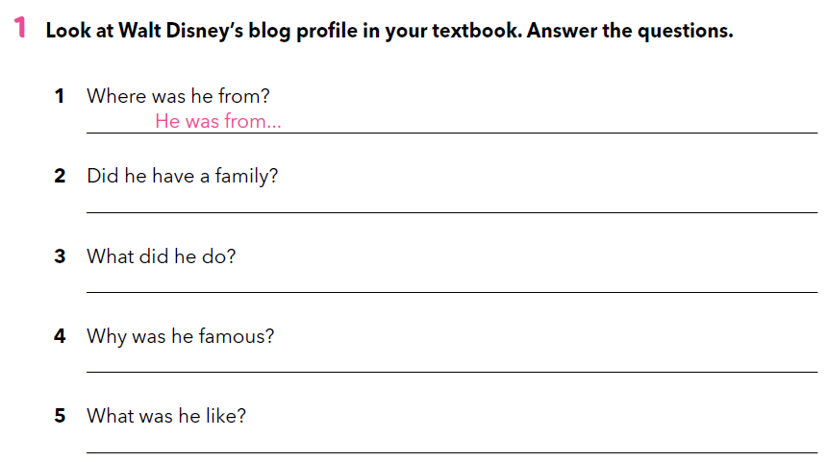
Workbook, p. 50
the USA.
He had his mum, dad, three brothers and a sister, a wife and two daughters.
He was a businessman, a film producer and a voiceactor.
He created Mickey Mouse and Disneyland.
He was creative and very successful.

Slide 10
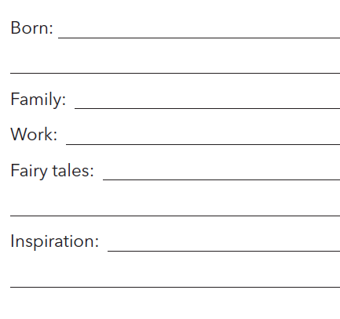
Read the text and fill in the profile.
H. C. Andersen was a Danish author. He wrote plays, novels, poems and fairy tales. His most famous fairy tales include “The Emperor’s New Clothes,” “The Little Mermaid,” “The Princess and the Pea,” “The Snow Queen,” “The Ugly Duckling,” “The Little Match Girl,” and “Thumbelina.”
Hans Christian Andersen was born in Odense, Denmark on 2 April 1805. He was an only child. His father’s name was also Hans, and his mother’s name was Anne.
He worked as an actor and a singer before he started writing. He never married, even though he was in love several times. Hans died in 1875.
There are two museums dedicated to his work, the Hans Christian Andersen Museum in Odense in Denmark and The Hans Christian Andersen Museum in Solvang, California. He inspired pieces of music, films, sculptors, video games, theme parks etc. There is even a mobile app for children called GivingTales, created in aid of UNICEF in 2015.

Slide 11
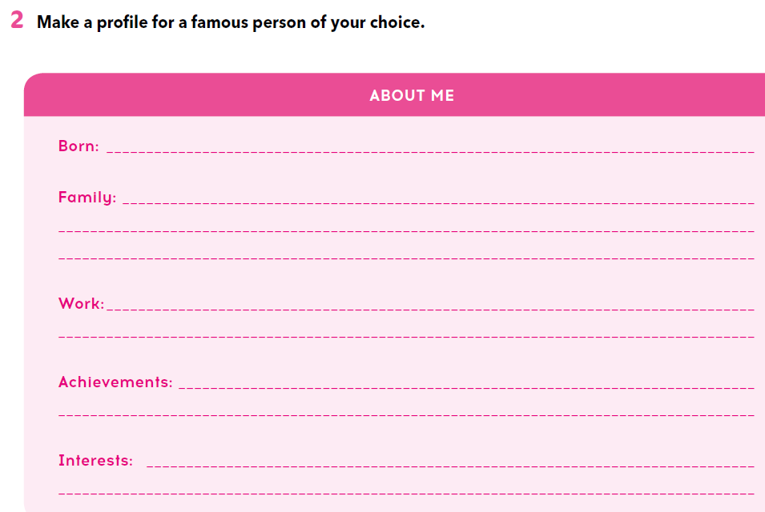
Workbook, p. 50

